Slide 1
Capstone Presentation

Slide 2
Business Problem
Invest
Where?
New York
Berlin
Exact location
On what?
Restaurant
Coffee Place
Bar/Nightclub

Slide 3
Where can we find data?
Location of cities:
Geolocator
Search for Specific cities e.g New York City, NY
Location of Stores:
Foursquare API
Free Developer account
Limited premium queries

Slide 4
How to wrangle data?
Used a notebook on Watson Studio
Use the pandas library to visualize data in a dataframe and get rid of unneeded data
Use the Folium library to create a map and visualize the stores produced from pandas

Slide 5
Discussion on the data
 | NEW YORK | BERLIN
Restaurants | 8862 | 2309
Bars/Nightclubs | 1408 | 1602
Coffee Shop | 1260 | 954
Americans enjoy eating out
Germans enjoy drinking out
Both lack vegan/vegetarian solutions
 | NEW YORK | BERLIN
Vegetarian/vegan restaurants | 65 out of 8862 (0.7%) | 148 out of 2309

Slide 6
Discussion on the data
Since both lack a vegan/vegetarian restaurant how cant we choose a city ?
Based on culture
Based on biggest market gap
Both variables favor New York

Slide 7
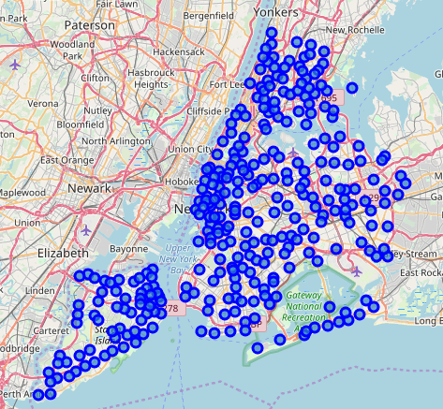
LOCATION
As simple as looking into a map

Slide 8
Conclusion
It is not a simple choice of a type of store and then of city, is a combination of both
New York seems to like food more, but has less vegetarian/vegan solutions.
Since there is a major absence of vegetarian/vegan solutions any location would be beneficial. But to avoid future or existing contenders we chose a location that have the less amount of stores.
Alternatively, a Berlin solution was provided.

